Slide 1

Understanding of Data
By Karishma Popli

Slide 2
Agenda:
Reasons Everyone Should Learn Data
What is the first step in understanding your data
Understanding Data
Derived Facts/Dimensions
Break
Building dimensions from Facts
Granularity of Data

Slide 3
Reasons Everyone Should Learn Data
“The data volumes are exploding, more data has been created in the past two years than in the entire previous history of the human race.” (Forbes)
1. Improve People’s Lives
2. Make Informed Decisions
3. Stop Molehills From Turning Into Mountains
4. Get The Results You Want
5. Find Solutions To Problems
6. Back Up Your Arguments
7. Be Strategic In Your Approaches
8. Keep Track Of It All
9. Access The Resources Around You

Slide 4
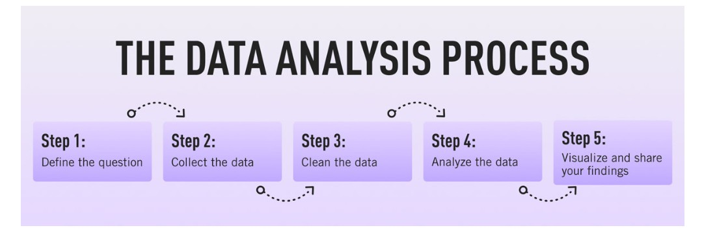
What is the first step in understanding your data

Slide 5
Understanding Data
Quantitative Data | Qualitative Data
Associated with numbers | Associated with details
Implemented when data is numerical | Implemented when data can be segregated into well-defined groups
Collected data can be statistically analyzed | Collected data can just be observed and not evaluated
Example: Height, Weight, Time, Price, Temperature, etc. | Example: Scents, Appearance, Beauty, Colors, Flavors, etc.

Slide 6
Understanding Data: Quantitative Data
Quantitative data is defined as the value of data in the form of counts or numbers where each data-set has an unique numerical value associated with it. This data is any quantifiable information that can be used for mathematical calculations and statistical analysis, such that real-life decisions can be made based on these mathematical derivations. Quantitative data is used to answer questions such as “How many?”, “How often?”, “How much?”. This data can be verified and can also be conveniently evaluated using mathematical techniques.
For Example:
I updated my phone 6 times in a quarter.
My teenager grew by 3 inches last year.
83 people downloaded the latest mobile application.
My aunt lost 18 pounds last year.
150 respondents were of the opinion that the new product feature will not be successful.
500 people attended the seminar.
54% people prefer shopping online instead of going to the mall.
She has 10 holidays in this year.
Product X costs $1000.

Slide 7
Understanding Data: Qualitative Data
Qualitative data is defined as the data that approximates and characterizes.
Qualitative data can be observed and recorded. This data type is non-numerical in nature. This type of data is collected through methods of observations, one-to-one interviews, conducting focus groups, and similar methods. Qualitative data in statistics is also known as categorical data – data that can be arranged categorically based on the attributes and properties of a thing or a phenomenon.
For example:
The cake is orange, blue, and black in color (qualitative).
Females have brown, black, blonde, and red hair (qualitative).

Slide 8
Discreate & Continuous Data
Discrete data
Discrete data is quantitative data that can only take on certain numerical values. These values are fixed and cannot be broken down. When you count something, you get discrete data.
For example, if a person has three children, this is an example of discrete data. The number of children is fixed—it’s not possible for them to have, say, 3.2 children. Another example of discrete quantitative data could be the number of visits to your website; you could have 150 visits in one day, but not 150.6 visits. Discrete data is usually visualized using tally charts, bar charts, and pie charts.
Continuous data
Continuous data, on the other hand, can be infinitely broken down into smaller parts. This type of quantitative data can be placed on a measurement scale.
For example, the length of a piece of string in centimetres, or the temperature in degrees Celsius. Essentially, continuous data can take any value; it’s not limited to fixed values. What’s more, continuous data can also fluctuate over time—the room temperature will vary throughout the day, for example. Continuous data is usually represented using a line graph.

Slide 9
Facts and Dimension Table:
Fact tables comprises of the facts of the system as its data content.
It is a table that has values of the attributes of the dimension table. It contains quantitative information in a denormalized form. It basically contains the data that needs to be analyzed. Fact tables mostly have two columns, one for foreign keys that helps to join them with a dimension table and others that contains the value or data that need to be analyzed. It mostly contains numeric data. It contains more records and fewer attributes.
Characteristics of Fact Table
Keys: Fact table consists of a key that is the combination or concatenation of all primary keys of various dimension tables associated with that fact table. Such key is called a concatenated key which uniquely identifies the row of the fact table.
Fact Table Grain: Grain of the table means the level of the detail or the deepness of the information that is stored in the fact table. The level must be the highest for designing an efficient fact table.
Outrigger Dimensions: The dimensions that have reference to any other dimension table are called as outrigger dimensions.
Sparse Data: Some records present in the fact table contain attributes with null values or measures i.e. these records do not give or provide any information.

Slide 10
Dimension Table
A dimension table contains the dimensions along which the values of the attributes are taken in the fact table. Dimension tables are small in size, contains only several thousand rows but the size can be increased occasionally. These tables are associated with a fact table through foreign keys.
Characteristics of Dimension Table
Keys: Every dimension table needs to have a primary key that helps to uniquely identify each record of the dimension table.
Attributes: Dimension table contains many attributes and therefore the dimension table appears to grow horizontally.
Attribute Values: The values in the dimension table are mostly in textual format and not in numeric format.
Relation Between Attributes: Attributes present in the dimension table are generally not directly related to each other but still are a part of the same dimension table.
Drilling Down, Rolling Up: Attributes present in dimension table permits to derive details through traversing from the higher level to lower level or it also allows rolling up from lower level to the higher level of the attributes.

Slide 11
Characteristics | Fact Table | Dimension Table
Basic Definition | It contains measurements, facts or metrics of the attributes. | It is the companion table that contains attributes using which fact table deduce the facts.
Design | It is defined by data grain. | It is descriptive, complete and wordy.
Task | It contains measures and is used for analysis and decision making. | It contains information about a business and its process.
Type of Data | It contains data in both numeric as well as textual format. | It contains data in only textual format.
Key | It has a primary key for each dimension which is acts as a foreign key in the dimension table. | It has a foreign key associated with the primary key of the fact table.
Storage | It stores the filter domain and reports labels in dimension tables. | It stores the detailed atomic data into dimensional structures.
Hierarchy | It does not have a hierarchy. | It contains a hierarchy.
Attributes | It has less attributes | More attributes
Records | More records | Less records.
Table Growth | The table grows vertically. | The table grows horizontally.
Creation Time | A fact table is created after dimension tables are created. | The dimension table needs to be created first.
Schema Structure | There is less number of fact tables in a schema. | There is a number of dimension tables in a schema.

Slide 12
Metrics/Measure/KPI
Metrics are measures of quantitative assessment commonly used for comparing, and tracking performance or production. Metrics can be used in a variety of scenarios. Metrics are heavily relied on in the financial analysis of companies by both internal managers and external stakeholders.
A measure is a fact table column that stores values to be summarized.
A key performance indicator (KPI) is a measurable value that demonstrates how effectively a company is achieving key business objectives. Organizations use KPIs to evaluate success at reaching targets. High-level KPIs may focus on the overall performance of the business, while low-level KPIs may focus on processes across departments like sales, marketing, HR, or support.

Slide 13
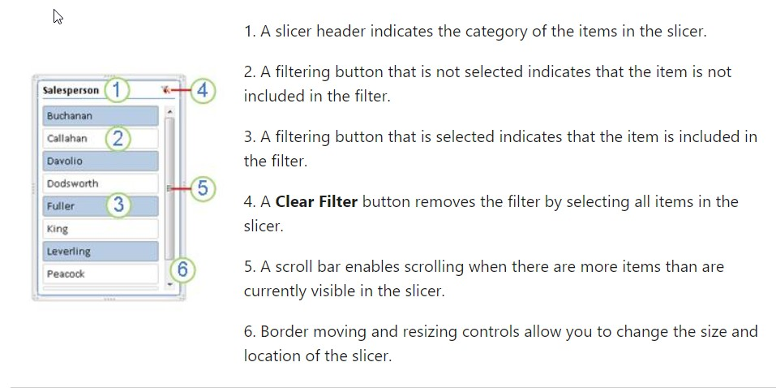
Perspective/Slicers
Perspective is the ability to think about problems and decisions in a reasonable way without exaggerating them.
Slicers: You can use a slicer to filter data in a table with ease.

Slide 14
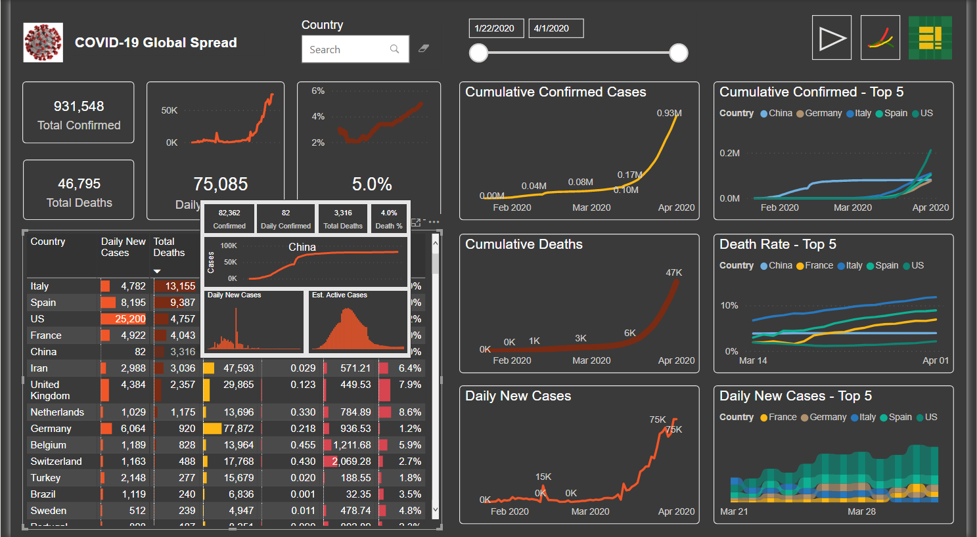

Slide 15
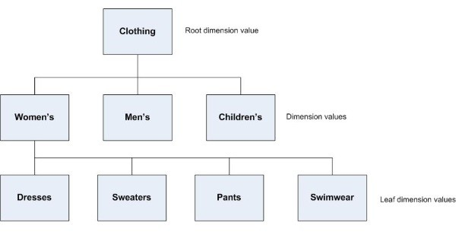
Hierarchical Dimension
A dimensional hierarchy denotes how data is organized at various levels of aggregation. An analyst uses a dimensional hierarchy to identify various trends at one level, drill down to lower levels to detect causes for these trends, and roll up to higher levels to see the effects the trends have on the whole business.

Slide 16
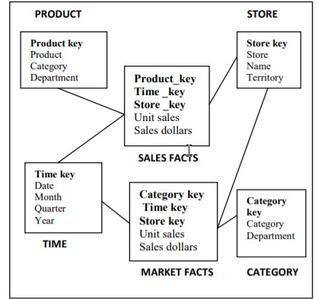
Derived Dimension/Fact
Derived tables can be powerful additions to the data warehouse, often used in the development of second level data marts that provide cross-functional analysis.

Slide 17
SIT STRECH AND RELAX

Slide 18
Building dimensions from Facts
To build a dimensional data model, you need a methodology that outlines the decisions you need to make to complete the database design. This methodology uses a top-down approach because it first identifies the major processes in your organization where data is collected. An important task of the database designer is to start with the existing sources of data that your organization uses. After the processes are identified, one or more fact tables are built from each business process. The following steps describe the methodology you use to build the data model.
A dimensional database can be based on multiple business processes and can contain many fact tables.
To build a dimensional database:
Choose the business processes that you want to use to analyse the subject area to be modelled.
Determine the granularity of the fact tables.
Identify dimensions and hierarchies for each fact table.
Identify measures for the fact tables.
Determine the attributes for each dimension table.
Get users to verify the data model.

Slide 19
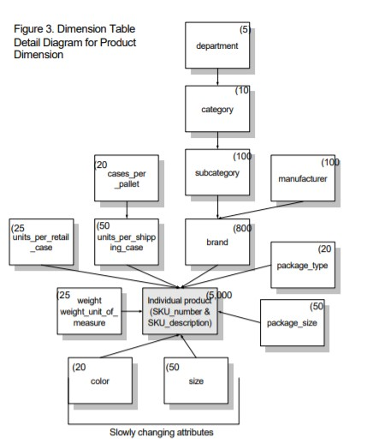
Activity: Design Fact/Dimension for Product Dimension

Slide 20
Granularity of Data
The granularity of data refers to the size in which data fields are sub-divided
Address = 200 2nd Ave. South #358, St. Petersburg, FL 33701-4313 USA
With fine granularity, as multiple fields:
street address = 200 2nd Ave. South #358
city = St. Petersburg
state = FL
postal code = 33701-4313
country = USA
OR even finer granularity
street = 2nd Ave. South
address number = 200
suite/apartment number = #358
city = St. Petersburg
state = FL
postal-code = 33701
postal-code-add-on = 4313
country = USA

Slide 21
Granularity of data is important to analyse it more better way and give us unique keys.
Primary Key
A primary key constrain is a column or group of columns in a table that uniquely identifies every row in that table. The Primary key can’t be a duplicate, meaning the same value can’t appear more than once in the table.
A table can have only one primary key. Primary key can be defined at the column or the table level.
Unique Key
A unique key is a group of one or more than one fields or columns of a table which uniquely identify database record.
A unique key is the same as a primary key, but it can accept one null value for a table column. It also cannot contain identical values.

Slide 22
Why use Unique Key?
Here are the important reasons to use unique key:
The purpose of a unique key is to make sure that information in the column for each table record is unique.
Unique key is used because it creates a non-clustered index by default.
Unique key can be used when you have to keep null values in column.
When one or more than one field/columns of a table that uniquely identify a record in a database table.

Slide 23
ANY Questions?

